Slide 1
Team I: General Hardware Agnostic Robot (GHAR) Software
Standards and Regulations Presentation
Notes:
Madhu - Part 2, 3, Part 4 for SLAM Subsystem Kshitij - Part 4 for Planning Subsystem Harshad - Part 5a and 5b (discuss 5b with rolanda) Rolanda - Part 4 for Robot Subsystem (discuss 5b with Harshad), Part 5c, 5d

Slide 2
Standards Chosen
ISO 13850:2015 - Safety of machinery — Emergency stop function — Principles for design
EMVA 1288 - Standard for Characterization of Image Sensors and Cameras

Slide 3
ISO 13850:2015 - Safety of machinery — Emergency stop function — Principles for design

Slide 4
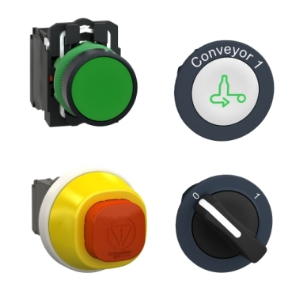
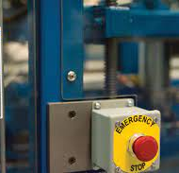
About ISO 13850:2015
Specifies functional requirements and design principles for the emergency stop function on machinery, independent of the type of energy used
An E-Stop function is defined as a system that can
avert arising or reduce existing hazards to persons, damage to machinery or to work in progress,
and be initiated by a single human action

Slide 5
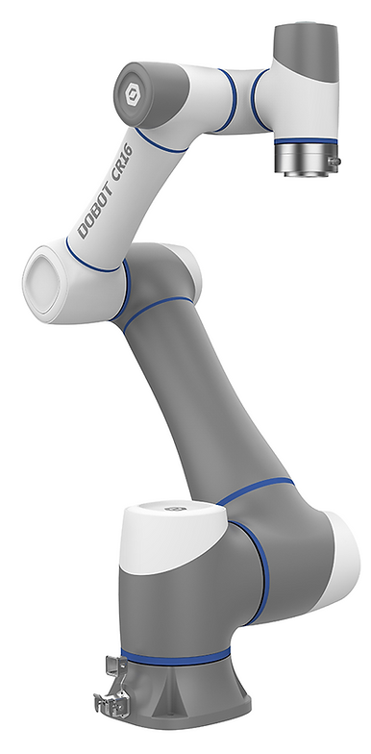
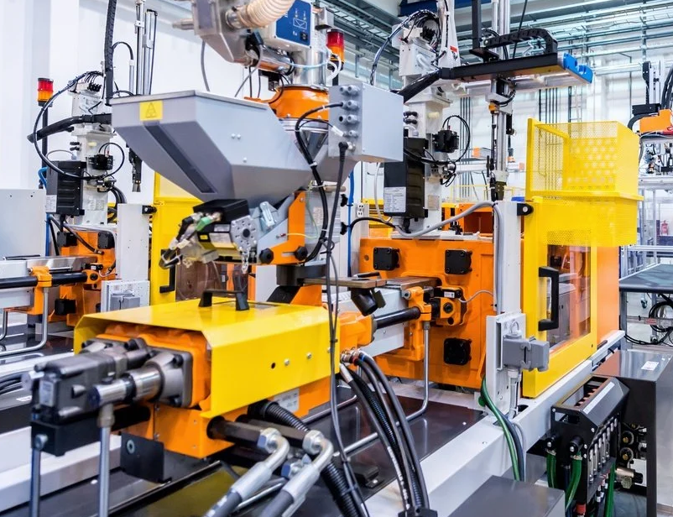
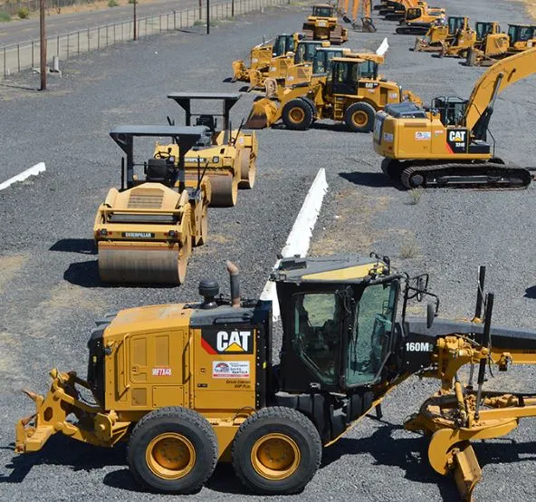
Relevant Products Covered by this Standard
Covers all markets that operate with dangerous machinery - for example construction, mining, manufacturing, etc.
Exceptions:
machines where an emergency stop would not reduce the risk
hand-held or hand-operated machines
It also does not deal with functions such as reversal or limitation of motion, braking or disconnecting, which can be part of the emergency stop.

Slide 6
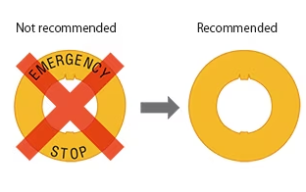
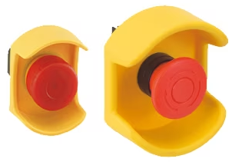
Major Prescriptions: Actuation
Actuator should be red, with as big of a yellow background as possible, and there should be no text on it.
The emergency stop device shall be designed to avoid unintended actuation, prevented by location rather than the use of other application design measures.
The use of a protective shroud around the emergency stop device should be avoided, unless necessary to prevent unintended actuation.

Slide 7
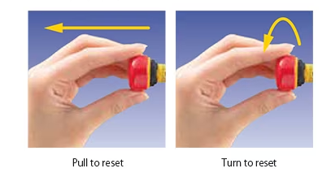
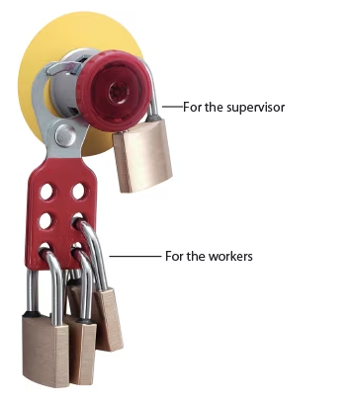
Major Prescriptions: Resetting
Resetting action should be intentional, operated by disengagement of an emergency stop device.
Machine shall be inspected before resetting.
Emergency stop device requiring a key on the actuator to be disengaged (unlatched) should be avoided.
Can use a padlock type system instead, to prevent resetting.

Slide 8
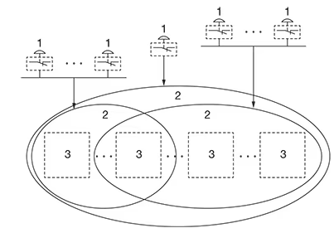
Major Prescriptions: Span of Control
Generally speaking, the span of control of each emergency stop device shall cover the whole machine
More than one span of control can be applied, if some requirements are met, such as:
the spans of control shall be clearly defined and identifiable
actuation of an emergency stop device shall not create additional hazards
actuation of an emergency stop device in one span of control shall not prevent the initiation of an emergency stop function in another span of control, etc.

Slide 9
Major Prescriptions: Other requirements & portable E-Stops
The systems involved in the emergency stop function shall comply with ISO 13849-1 and/or IEC 62061.
The minimum required specification is PLr c or SIL 1.
Detachable or portable E-stops may be used, but at least one permanent E-stop must always be installed on the machine.
One of these measures shall be applied to avoid confusion between active and inactive devices:
device colour changing through illumination of the active emergency stop device;
automatic (self-actuating) covering of inactive emergency stop devices;
provision of proper storage for detached or cableless operator control stations.

Slide 10
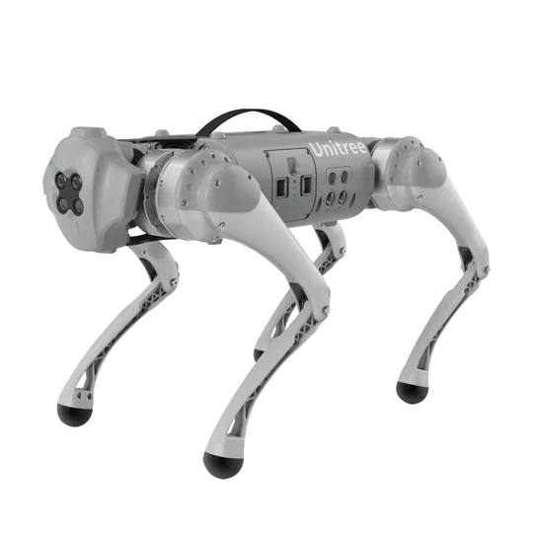
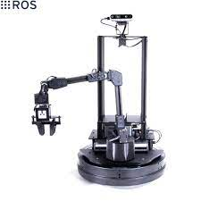
Applicability to our project
We operate with the locobot and Unitree Go1, which are expensive pieces of hardware
Both these robots are heavy enough to cause harm to humans and other objects
Our robots are fully autonomous, and hence can take actions that are dangerous.
We are operating in indoor environments with narrow spaces, which increases the chances of the robot hitting something.

Slide 11
EMVA 1288 - Standard for Characterization of Image Sensors and Cameras

Slide 12
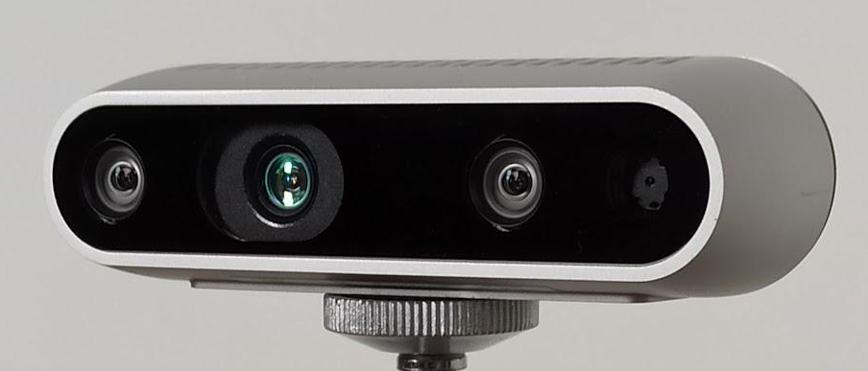
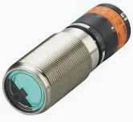
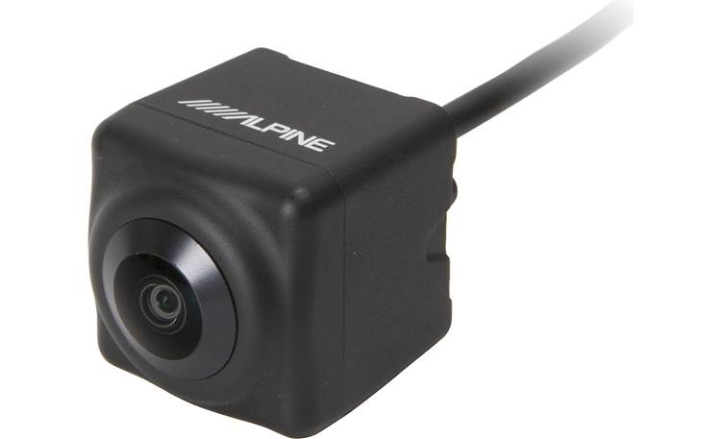
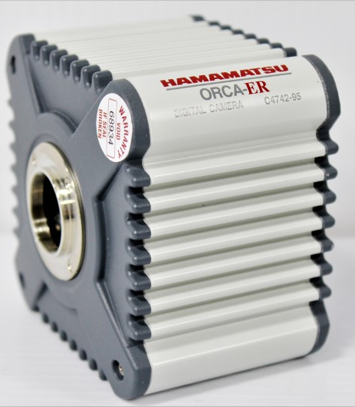
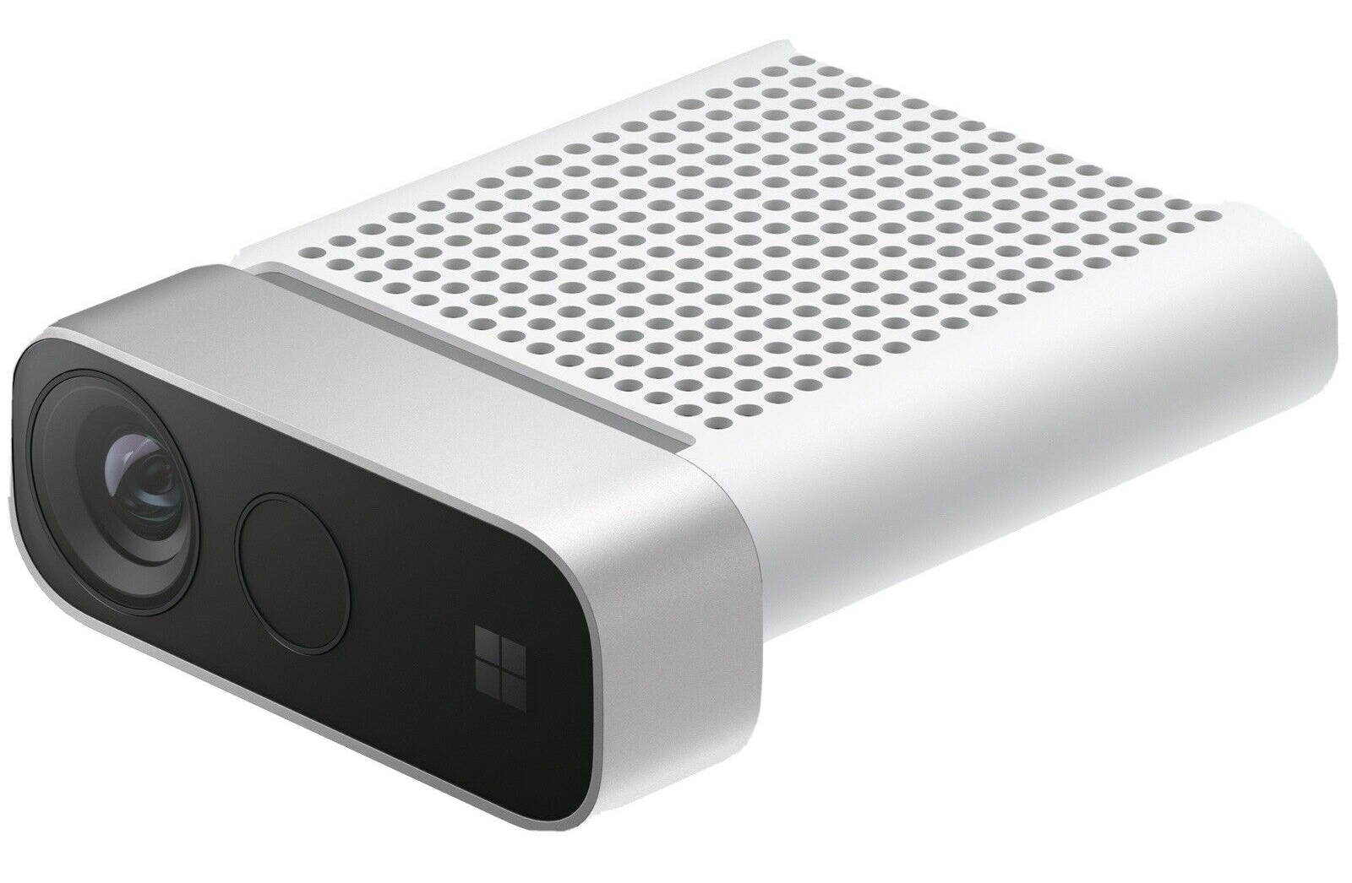
About EMVA 1288
EMVA1288 is an initiative to standardize parameters and characterization data for cameras and image sensors used in machine vision applications.
The standard supports the characterization of multimodal sensors, including polarization, multispectral, and time-of-flight sensors
The goal is to allow the user to effectively compare cameras from different manufacturers

Slide 13

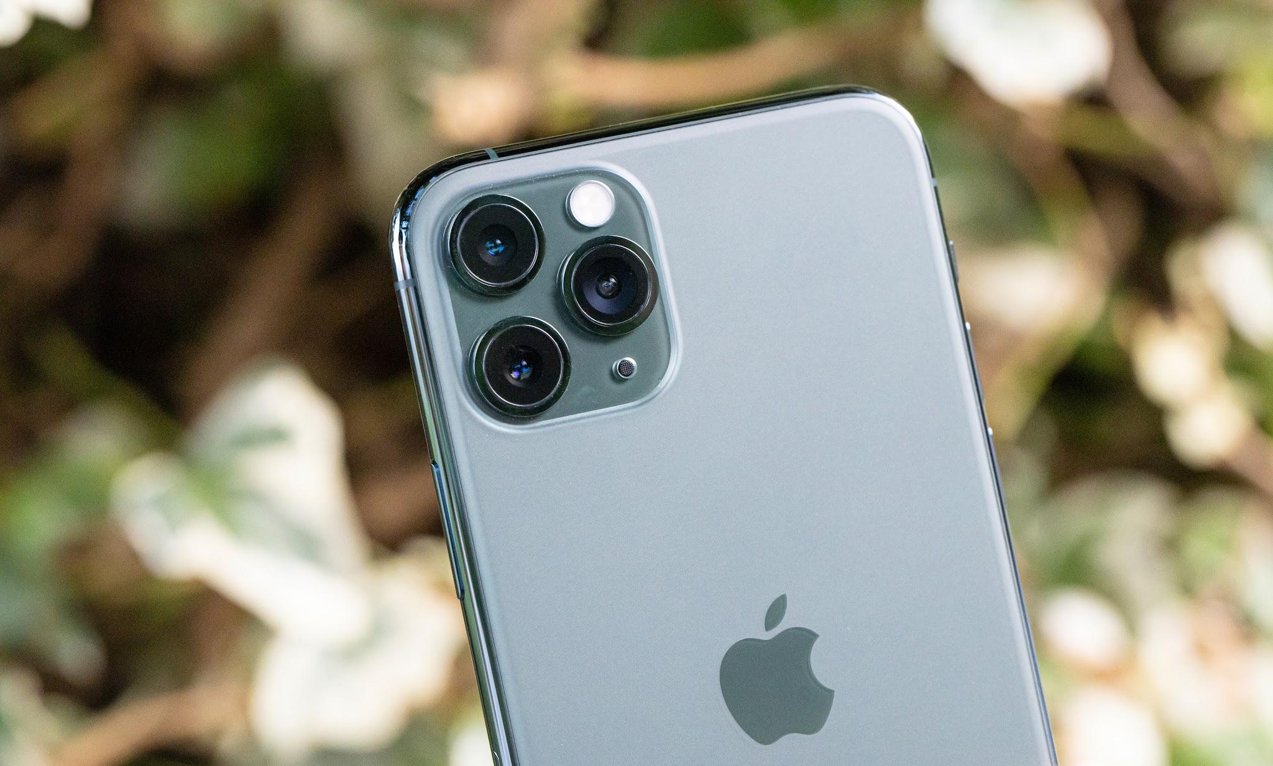

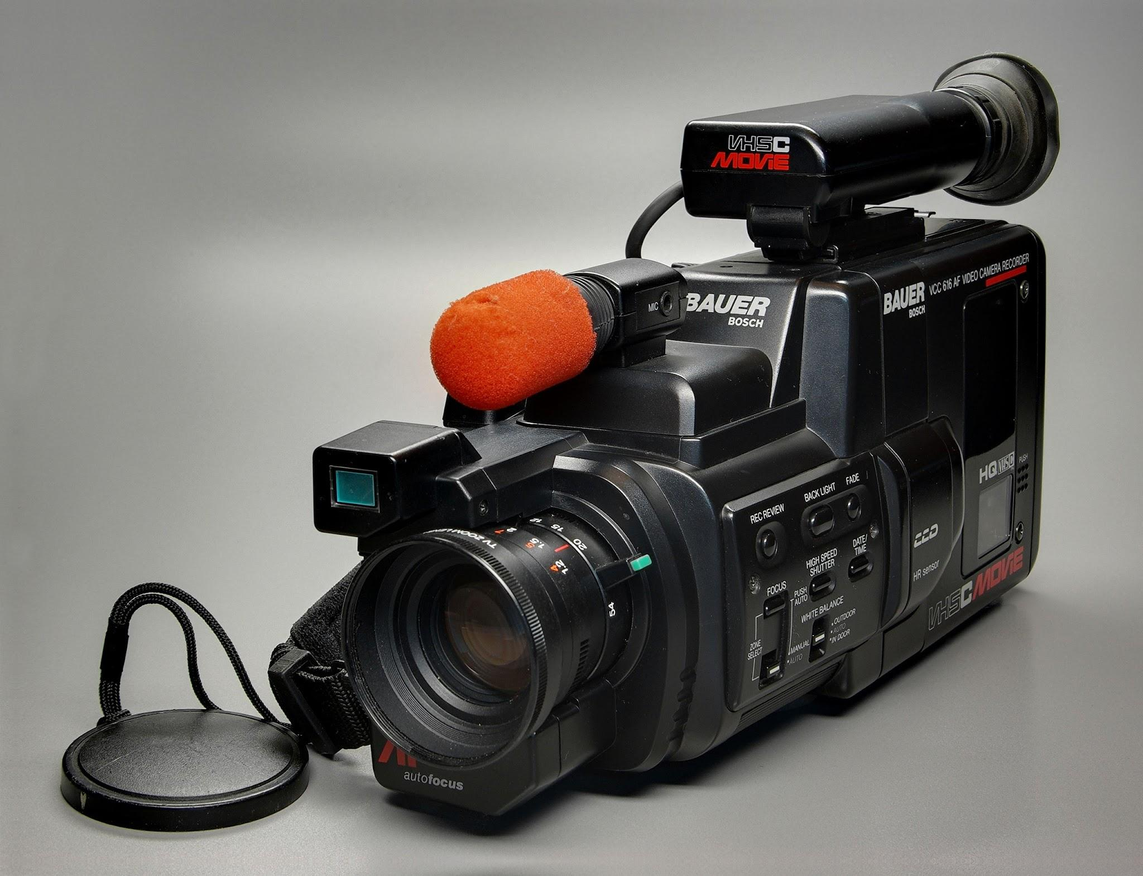
Relevant Products Covered by the Standard
Applicable to cameras that are used for computer vision applications
Previous releases only focused on monochromatic cameras
However, the newest release (Release 4) also focuses on depth cameras, multispectral cameras, polarization cameras, etc.
Does not focus on commercial cameras used for photography and videography

Slide 14
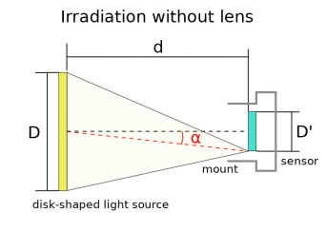
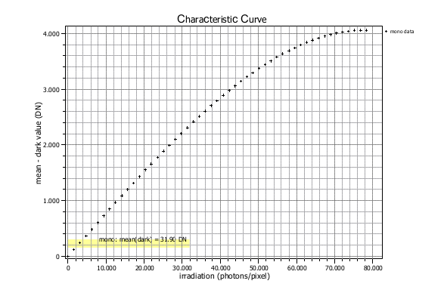
Major Prescriptions – Sensitivity and Noise
A setup with a light source is required that irradiates the image sensor homogeneously without a mounted lens. The f-number (d/D) must be 8.
The mean-gray values and the temporal variance of gray values is measured, with increasing irradiance.
Using the graph obtained, the Saturation, Temporal Dark Noise, Absolute Sensitivity Threshold, Saturation Capacity and Dynamic Range is calculated

Slide 15
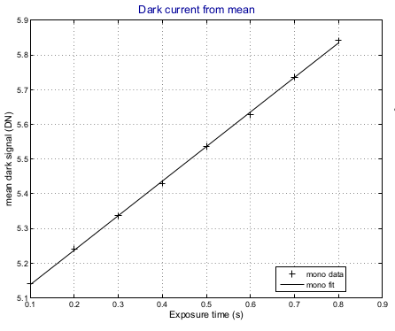
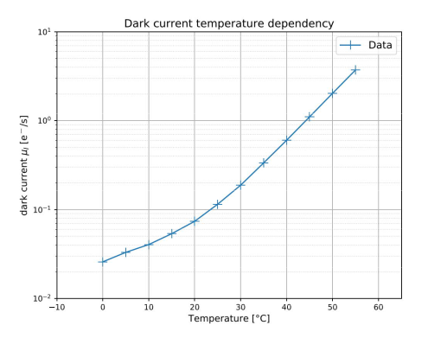
Major Prescriptions – Dark Current
Measured without the illumination source, using a capped camera
Measure signal strength over at least 6 equally spaced exposure times.
Also run the experiment for 6 equally spaced temperatures over the operating temperature range of the camera

Slide 16
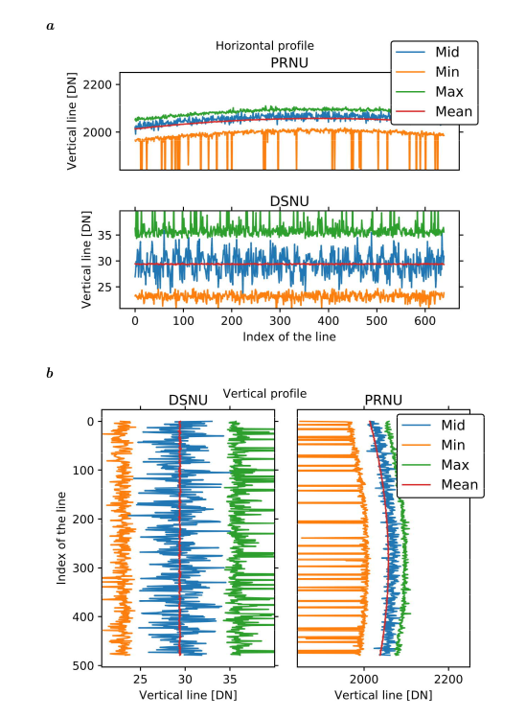
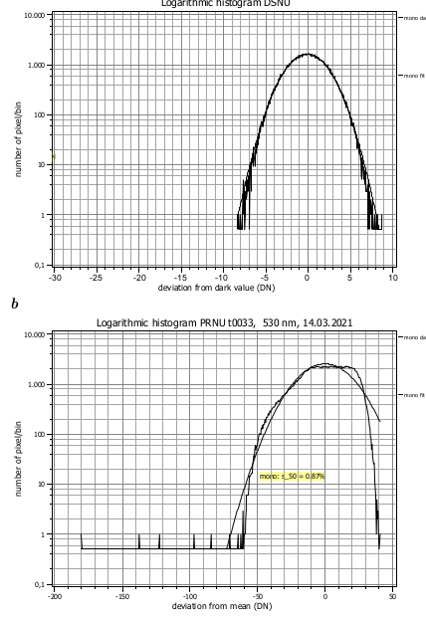
Major Prescriptions – Sensor array non-uniformities and defect pixels characterization
Same setup as sensitivity and noise measurement, but 100-500 measurements are required
A high-pass filter is applied to remove effects due to the lens and uneven illumination
The horizontal and vertical spectrogram and profile is plotted, using calculated DSNU and PRNU values
The accumulated logarithmic histogram is used to characterize defective pixels

Slide 17
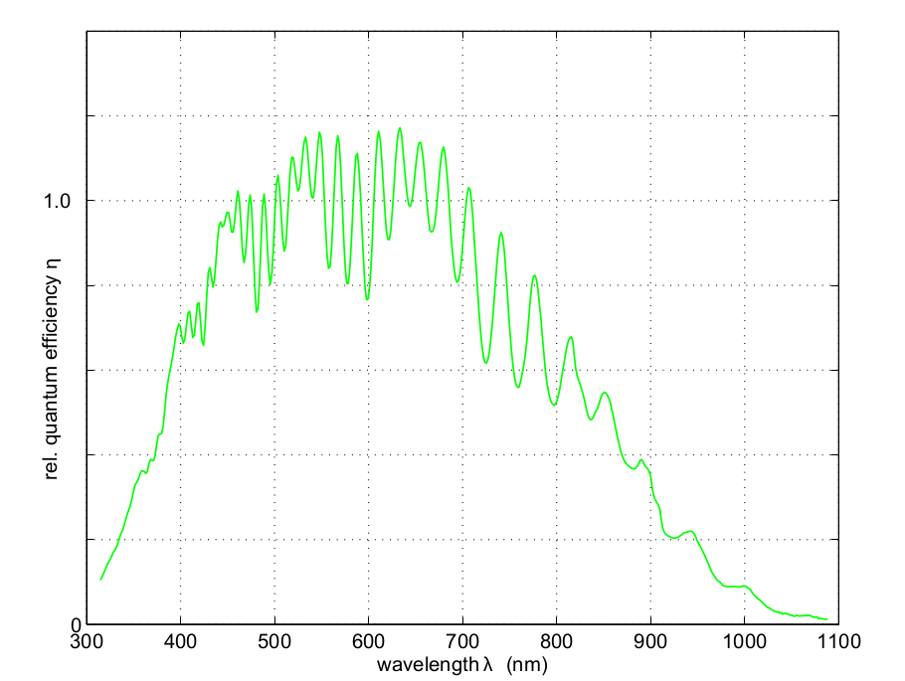
Major Prescriptions – Spectral Sensitivity
Geometric setup is same as the sensitivity and noise measurement, but light source must be spectral (can be switched to different wavelengths).
Similarly measure mean gray values over the entire wavelength range that the camera responds to, in 10 nm increments.
Compute mean spectral gray value, and the quantum efficiency curve.

Slide 18
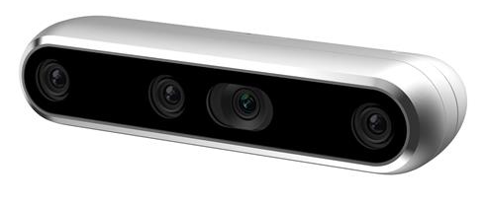
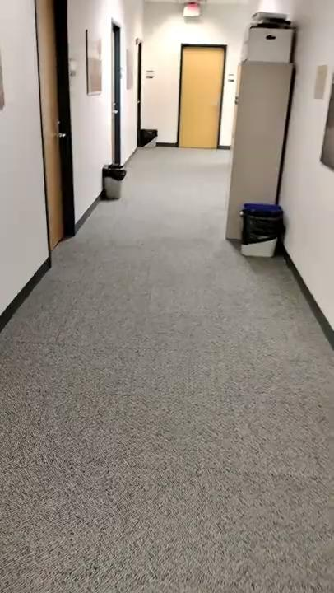
Applicability to our project
The SLAM subsystem uses a depth camera - Realsense D435i
We are operating in indoor environments, so there is a large variance in lighting conditions
Hence, it is important to understand how the camera sensitivity and noise change under different levels of irradiation
Sensor array non uniformities and defective pixels is also going to affect our mapping accuracy.

Slide 19
Questions?
Thank You!
Notes:
Descope: Planning time: 1 min Determine object negotiability with 80% accuracy

